Slide 1
The Design of Hey and Lotito
John Hey

Slide 2
Overview
This presentation is to explain the design and implementation of the Hey and Lotito experiment:
Naïve, Resolute or Sophisticated? A Study of Dynamic Decision Making, Journal of Risk and Uncertainty, 38, 1-25, 2009, doi:10.1007/s11166-008-9058-5.
It would be helpful to read the paper and experience the software first.

Slide 3
The purpose of the experiment
To understand how people tackle dynamic decision problems.
In particular, to distinguish between different types of decision-maker (DM):
Resolute
Naïve
Sophisticated
These are different ways that a DM may tackle a dynamic decision problem.

Slide 4
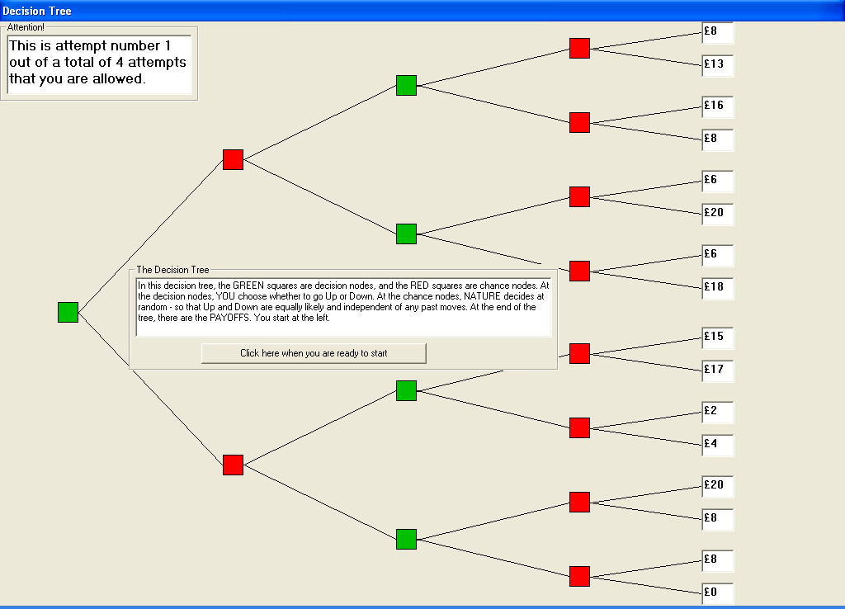
Remember this problem?

Slide 5
The different types
Resolute: Decides on a strategy at the beginning and implements it regardless.
Naïve: Thinks of the problem as a sequence of one-stage problems and tackles each independently of the others.
Sophisticated: At the first stage, anticipates his/her decision at the second stage and takes that it into account at the first stage.
(Conventional) Economics assumes that all DM’s are sophisticated – that is, that they use backward induction.

Slide 6
The design
We wanted to give subjects a series of decision-problems through which their type would be revealed.
In order to explain this, we need to anticipate what we planned to do with the data from the experiment.

Slide 7
Our data analysis
Our data are the decisions of each subject at each decision node at which the subject took a decision. We also asked subjects to evaluate each tree (using the second-price sealed-bid auction method).
We fit subject-by-subject and assume that each subject has Rank Dependent Expected Utility* preferences. This has embedded in it a utility function and a probability weighting function. We took two values for each: utility CARA and CRRA; weighting function Khaneman & Tversky and Power. There is a risk-aversion parameter, r, for utility and a weighting parameter, g, for the weighting function.
Taking each type in turn for each subject, we fitted the type by maximum likelihood, gaining estimates of the parameters and the goodness-of-fit.
We used the latter to determine the type of each subject.
*If subjects had Expected Utility preferences all types would do the same.

Slide 8
Some Detail on Functional Forms
Utility
CARA: u(x)=-exp(-r*x) if r≠0; =x if r=0
CRRA u(x)=x^{r}
Weighting function
Kahneman
Power
w(p)=p^{g}

Slide 9
The trees used in the experiment
We used three sets each with four trees, with different values for the payoffs and the probabilities, giving a total of 12 decision trees.

Slide 10
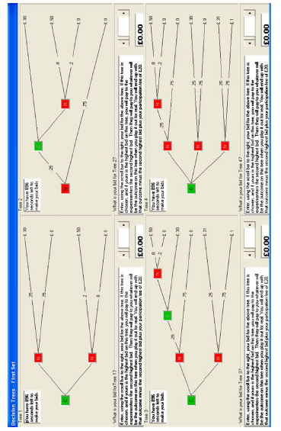

Slide 11
Crucial to the design are different trees
Some one-stage, some two-stage.
They were designed so that different types would take different decisions.
Though we note that preferences (risk-aversion and weighting parameter) also determine the decisions as well as the type.
Clearly we need to simulate before running the experiment to ensure that the different types can be identified.
The trees were designed on this basis.
In general, extensive simulations are necessary to decide the problem sets (and the number of them).

Slide 12
Choice of problems
Note that decisions depend not only on the type of subject but also his or her parameters (risk-aversion and probability weighting).
So we need to make sure that the problems in our experiment (the probabilities and the amounts of money) are such as to enable us to distinguish different types for parameters we might encounter.
So we crucially need to carry out a pilot experiment to check that our design works.
This costs money, but will save money (from getting data which does not answer our questions).

Slide 13
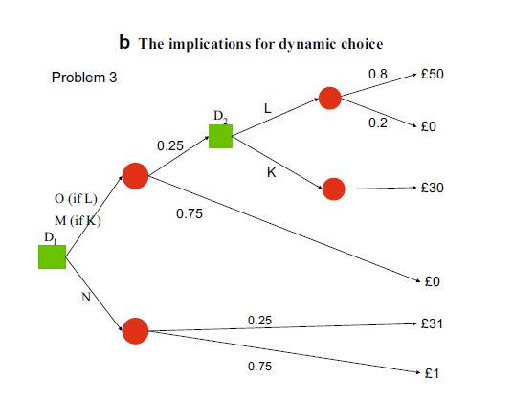
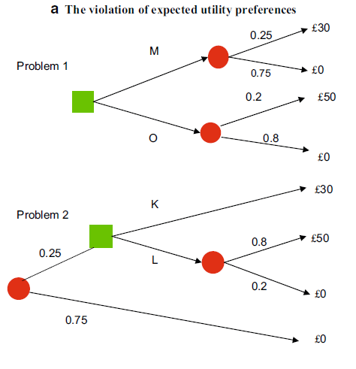
Let me discuss the problem of dynamic inconsistency

Slide 14
Consider first Fig. 1a and consider an individual who prefers O to M in Problem 1 and prefers K to L in Problem 2. These preferences imply a violation of Expected Utility theory in the form of a violation of the Independence Axiom. Now consider how such an individual would tackle Problem 3, in which there are two decision nodes D1 and D2. Suppose this individual is at decision node D2. Then her preferences indicate that she would choose to move Down at that node, because she prefers K to L. Now look at the situation as viewed from node D1. As viewed from there, if she moves Up at that first node, then she is faced with either getting O (by moving Up at D2) or getting M (by moving Down at D2); if she moves Down she is faced with getting N. Assume that for this individual O is preferred to N, which is preferred to M. Then as viewed from node D1 she prefers O, and that, by assumption, is preferred to the lottery obtained by moving Down at D1 namely N. Hence she sets off by choosing Up at D1. A problem arises, however, if she arrives at node D2. As we have already argued, at this node Down is preferred, and so, if the preferences at that point are followed, the individual will choose Down at node D2. Hence the individual, in arguing in this way, plans, at node D1, to choose Up at node D2 but, if she arrives there, actually chooses Down.

Slide 15
This is dynamic inconsistency: adopting a plan but then not implementing it at a later node. Moreover, it is a problem to the individual when at node D1. If she is aware of this dynamic inconsistency, then she realises that by choosing Up at D1 and then choosing Down at D2 she therefore ends up with the lottery M which is dominated by
the lottery N—which she could get by choosing Down at D1.
What might the individual do about this dynamic inconsistency? Well, she might simply be unaware of it, or ignore it, acting naively, and choose at each point the strategy most preferred from the perspective of that point—Up at D1 and then Down at D2. However, if she is aware of this dynamic inconsistency, she might want to do something about it. One possibility is that the individual, anticipating the fact that she will choose Down at D2, if she reaches it, realises that it would be better to choose Down at node D1. This, in the literature, is termed acting sophisticatedly.
This sophisticated individual anticipates her future behaviour, and avoids the inconsistency by making a choice at the initial decision node which is constrained by her anticipated choice at each following node.

Slide 16
Design is over; now implementation
This software was written in Visual Studio.
That is good for drawing pictures but is quite difficult to write.
Note that part of the experiment (valuing the trees) involves a second-price auction.
So all subjects in a session put in bids for each tree and the winner is the one who bids the highest and he/she pays the second-highest bid.
(Theory says that the optimal bid is the valuation.)
This is NOT an interactive experiment, but it does require analysis of ALL subjects’ responses.

Slide 17
Implementation
The experiment was conducted at EXEC, the Centre for Experimental Economics at the University of York.
A total of 50 students, both graduate and undergraduate took part. They were given written instructions which were read aloud.
When all participants had finished reading the instructions, a PowerPoint presentation was played at a predetermined speed on their individual screens.
After this, they could ask questions.
The experiment then started.

Slide 18
Data Analysis
After the experiment, we analysed the data, wrote up the results and published the paper.
It took some 2 years from start to finish.

Slide 19
The end…
…of the design and implementation of Hey and Lotito.
I would be happy to answer questions.

